Slide 1
Generating Flat File Reports for Specific Regions in the Emissions Inventory System (EIS)

Slide 2
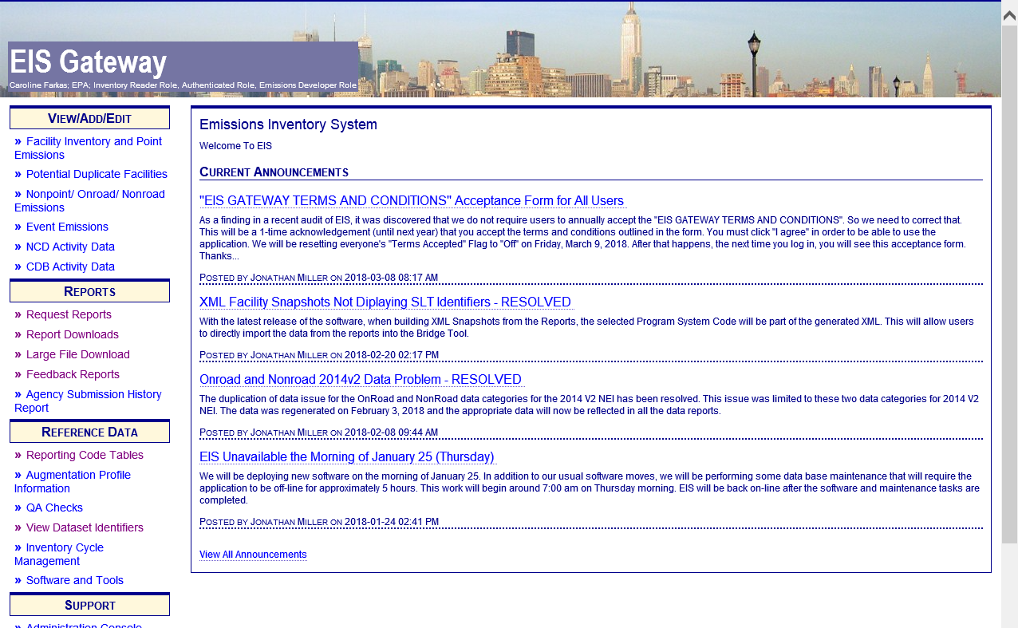
Go to Reports Section of EIS

Slide 3
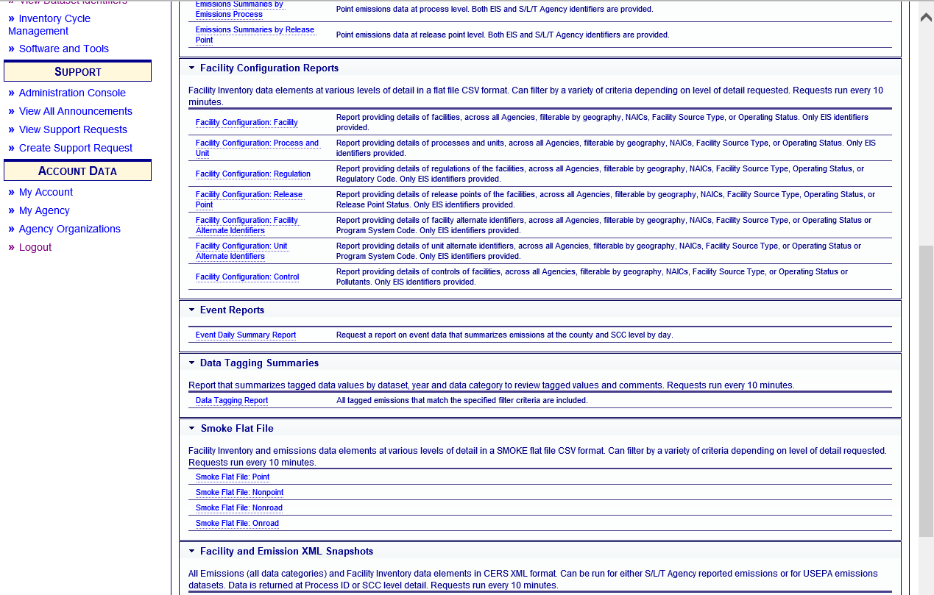
The SMOKE Flat File
is one type of report
available. Other reports
support various levels
of aggregation:
e.g., facility, unit, release point, process

Slide 4
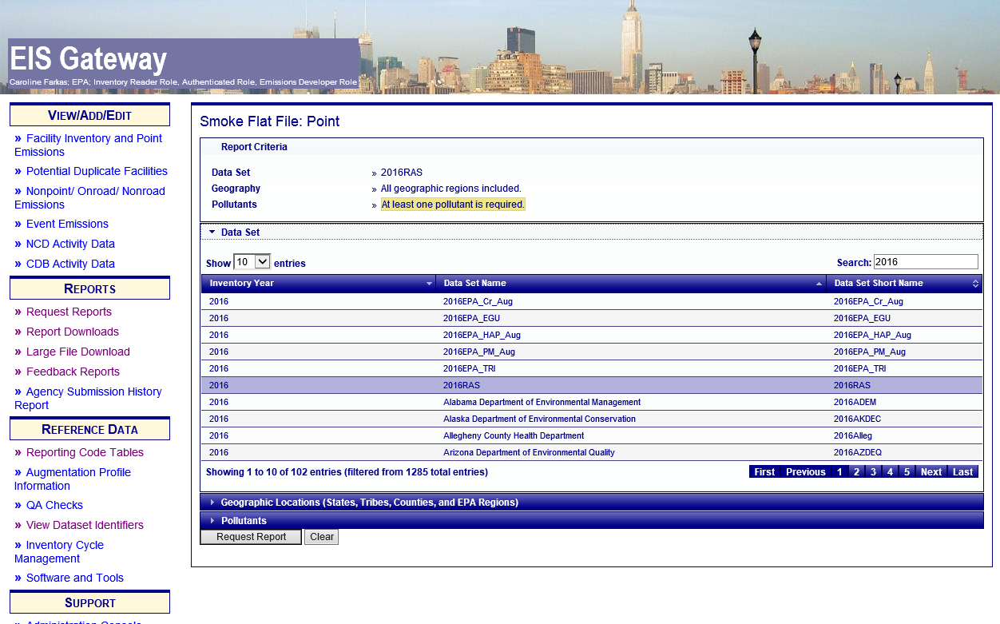
*
* NOTE: The Responsible Agency Selection (RAS) contains S/L/T data but not all EPA data; The RAS is available sooner than the full selection; for 2016 this will be: 2016 NEI Draft v1

Slide 5
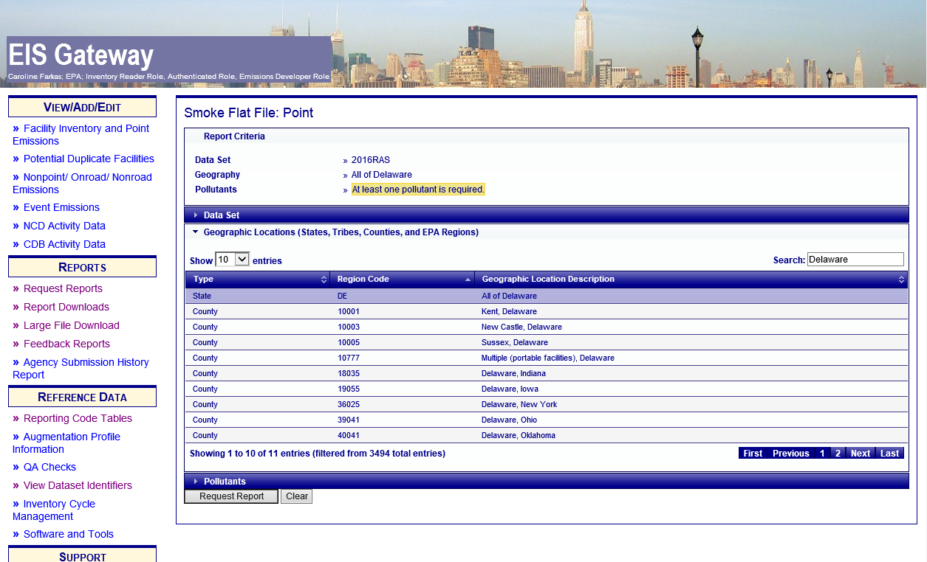
Here we are picking the State of Delaware

Slide 6
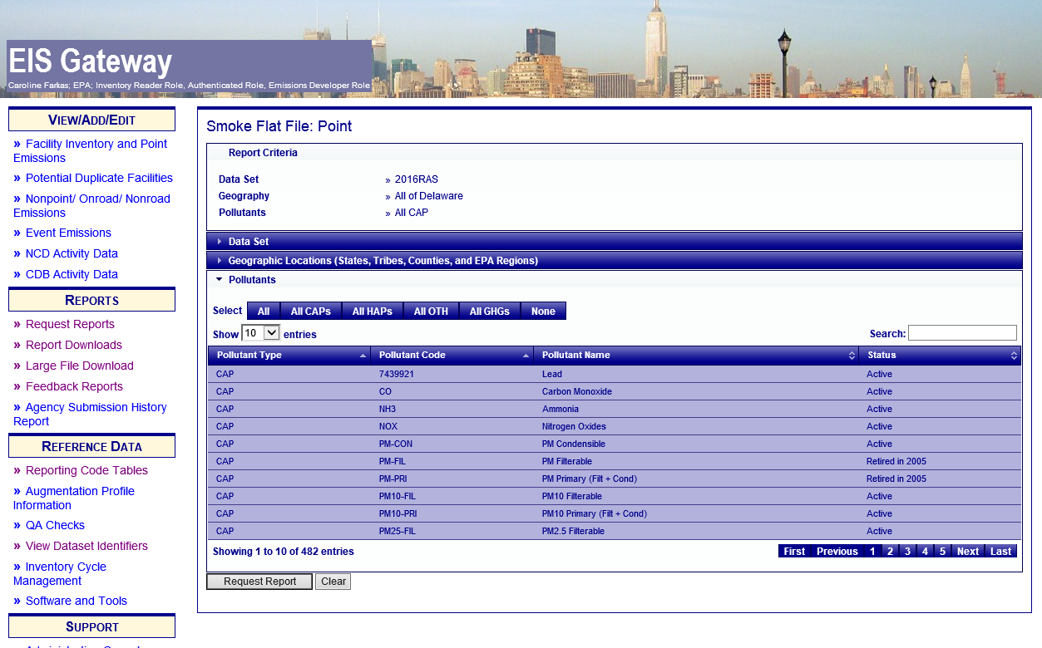
Limiting this report to CAPs only

Slide 7
Next, find the report in the Downloads Ares

Slide 8
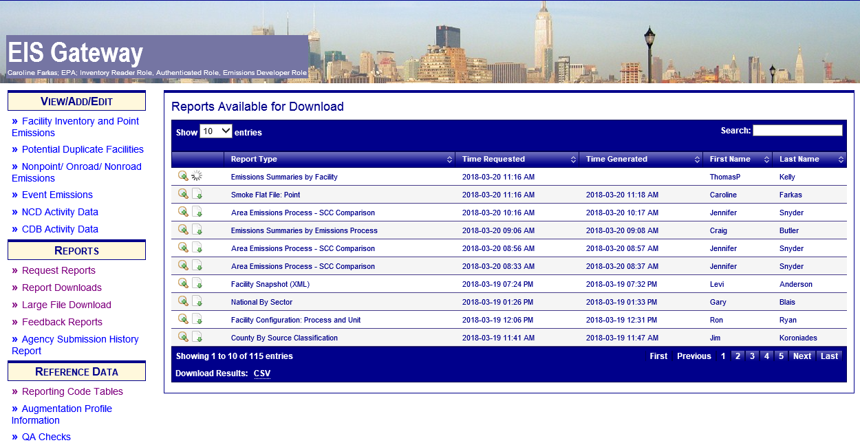

Slide 9
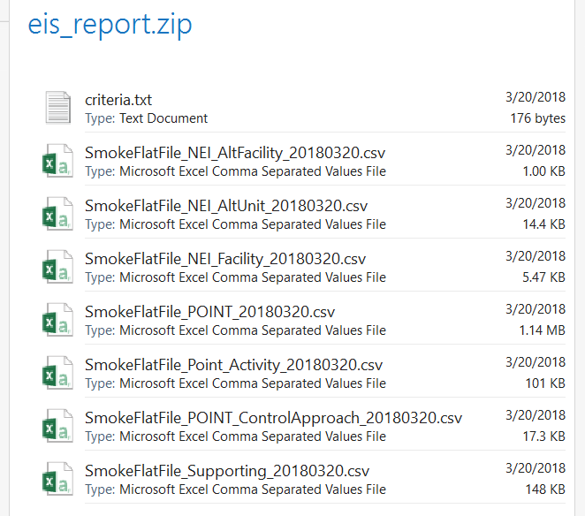
The resulting file downloads as a .zip file containing various information including the flat file

Slide 10
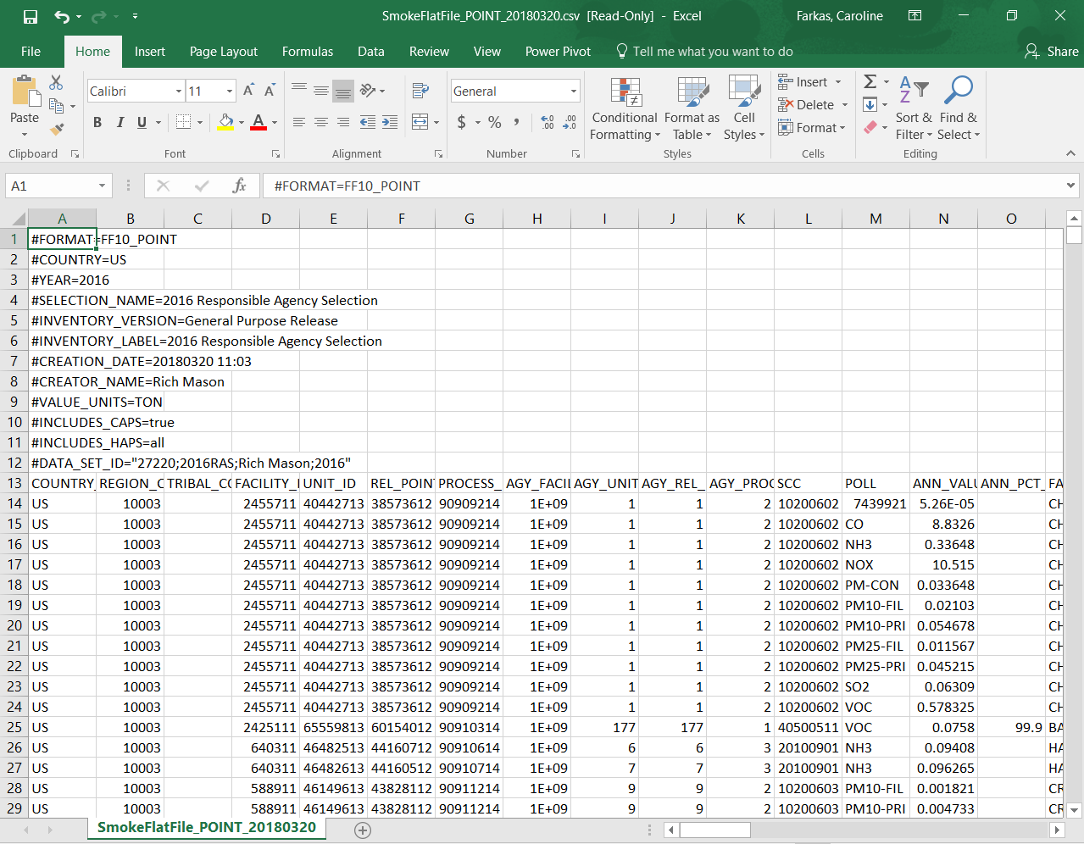
This is how it looks once loaded.
The top rows are descriptive metadata – you can move them to a README tab or delete them.

Slide 11
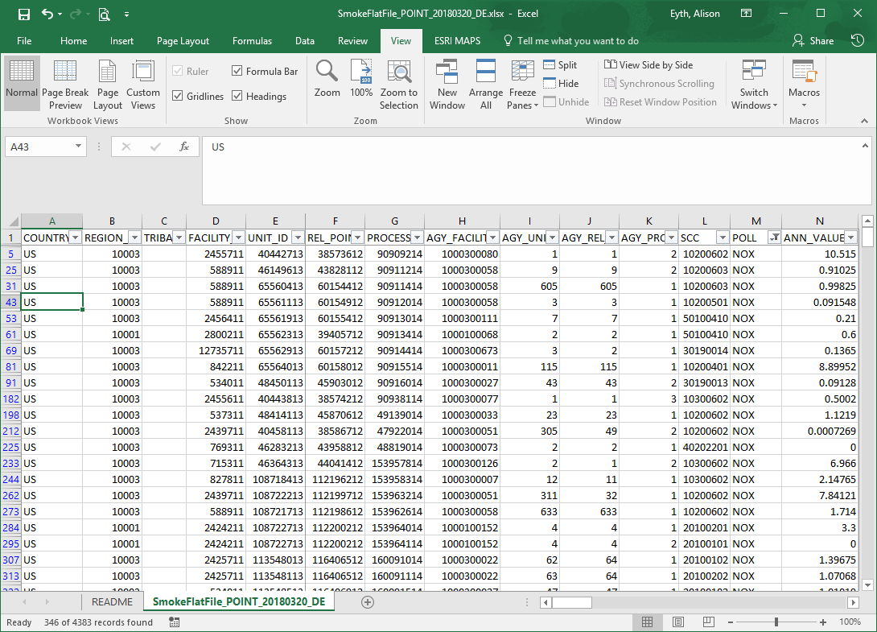
After loading into
Excel, you can filter, sort, and freeze panes.
Key columns include:
Both EIS and agency IDs,
SCC, POLL, ANN_VALUE

Slide 12
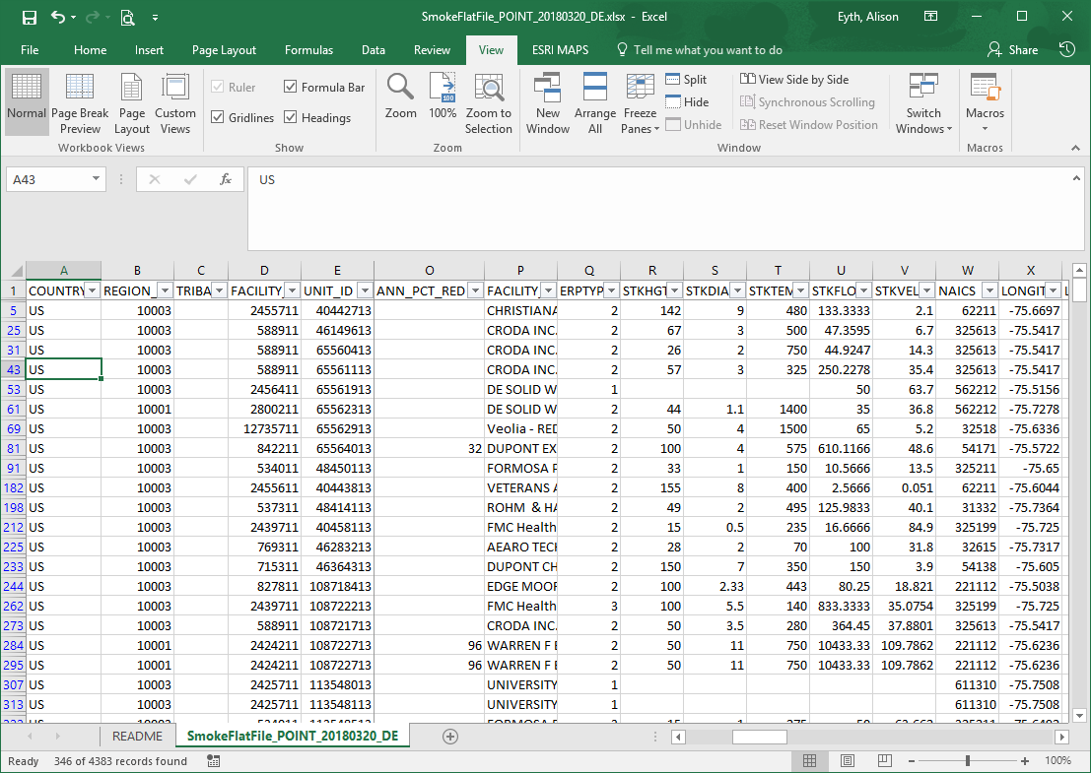
Other key columns:
ANN_PCT_RED:
percent reduction
from controls;
Facility name,
ERPTYPE (stack=2 or
fugitive=1),
Stack parameters,
NAICS (oil&gas split)
Lat/Lon cords

Slide 13
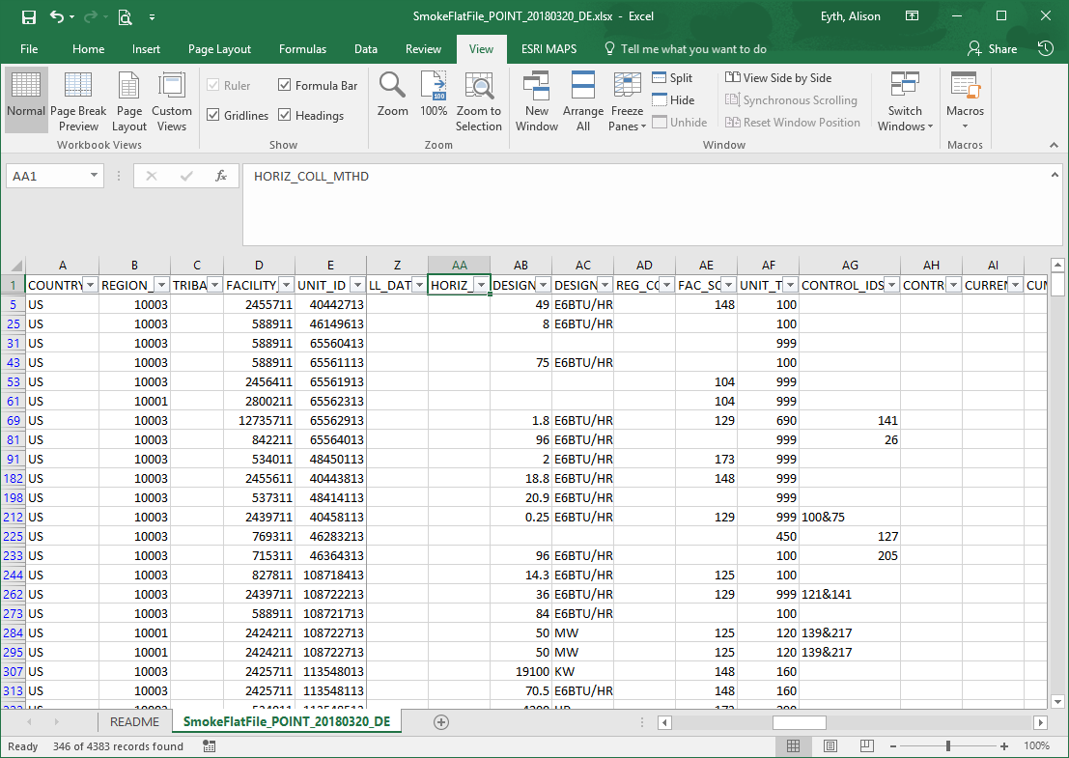
More key columns:
Design capacity,
Design cap. Units,
Facility source type,
Unit type,
Control IDs – for
Measures in EIS

Slide 14
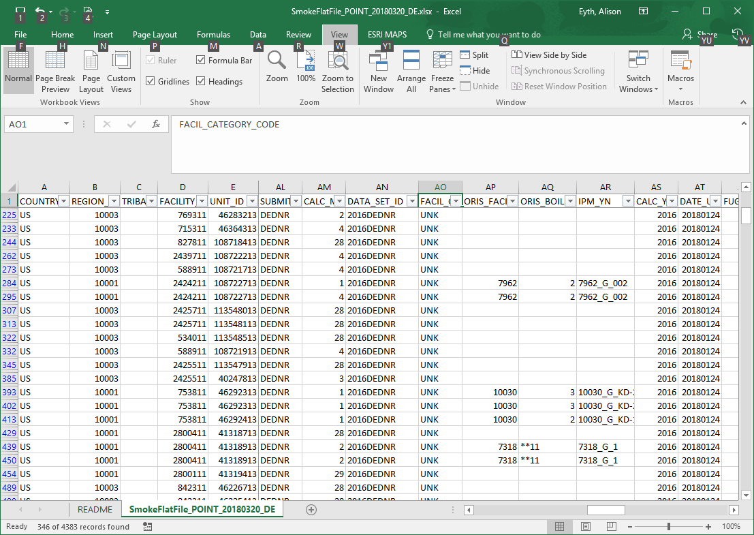
More key columns:
Submitter ID
(e.g., state, EPA),
CALC_METHOD,
DATA_SET_ID,
ORIS_FACILITY_CODE,
ORIS_BOILER_ID,
IPM_YN,
CALC_YEAR,
DATE_UPDATED

Slide 15
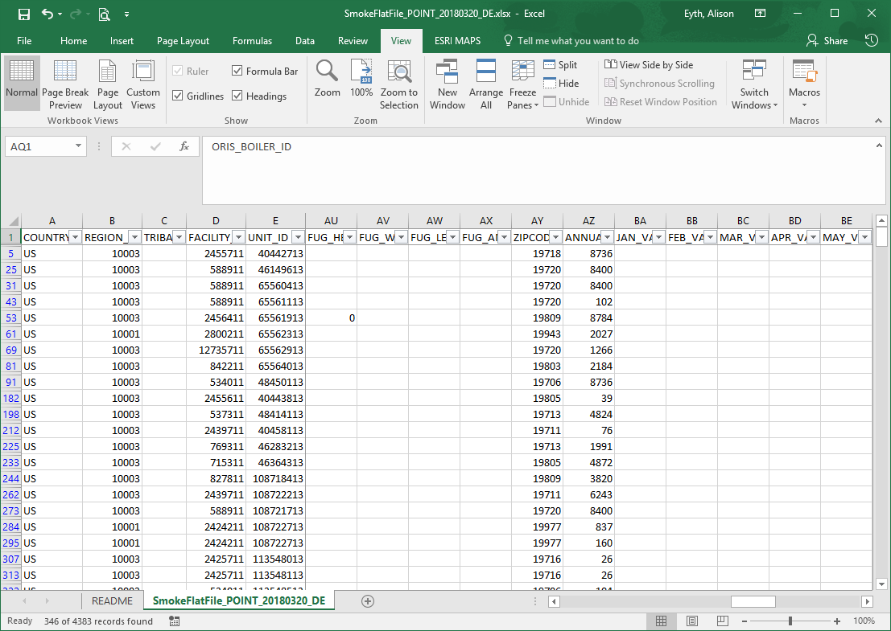
Rightmost columns:
Fugitive parameters,
Zipcode,
Annual_avg_hours_ per_year,
Monthly emissions
(if available),
Monthly percent reductions (if avail.),
comment

